Slide 1


Approaches to Internationalising Ly Tu Trong College curriculum in collaboration with City of Glasgow College.

Slide 2
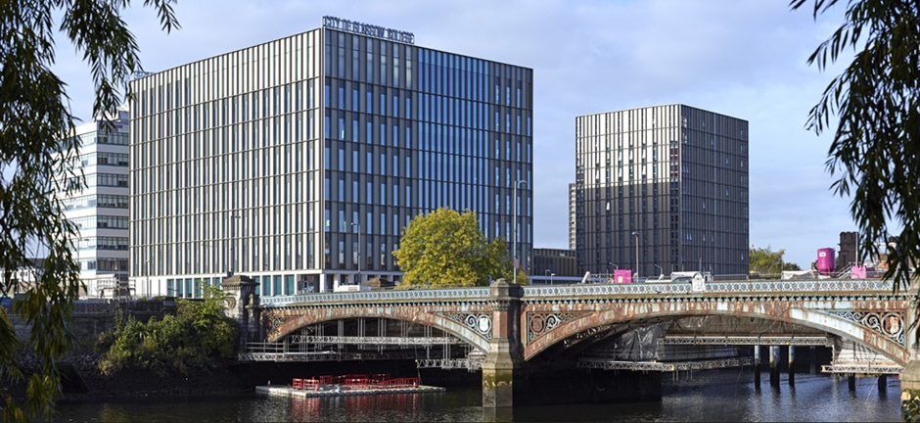

City of Glasgow College (CoGC)
City of Glasgow College is the largest and most diverse college in Scotland. It is the top college in the UK for WorldSkills and composite number one in the Scottish sector for success in student achievement in combined Further and Higher Education
Has more than 26,000 students, of which students are from over 130 countries
More than 2,600 programmes across a range of subjects
Links with 1,500 industry partners and 85 international partners
Excellent reputation as many of the students have won many national and international awards

Slide 3
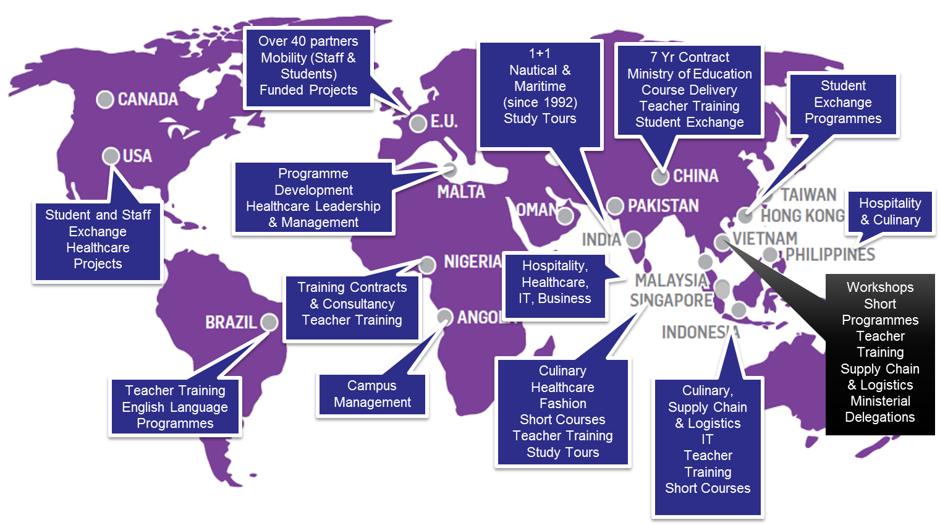
City of Glasgow College International Activities

Slide 4
Internationalisation Options
Following the identification of Ly Tu Trong College’s needs, both City of Glasgow College and Ly Tu Trong College have identified the following areas of collaborations:
  Deliver Professional Certificate or Professional Diploma programmes in Vietnam
  Teachers Training and/or Guest Lecturers from City of Glasgow College to deliver at Ly Tu Trong College
  Teachers Training at City of Glasgow College
  Study Tour at City of Glasgow College
Note:
For (i) and (ii), please refer to City of Glasgow College proposal that was sent on 3rd June 2019.

Slide 5
Internationalisation Options
Professional Certificate and Professional Diploma Programmes

Slide 6
Professional Certificate
Mechanical Engineering, English, Construction, IT or Electrical Engineering
Four Days Training
3½ Days Teacher Training
Half Day Student Guest Lecture
GBP 7,300 for each subject (up to 35 Staff)
International Trainer
Delivered in English (Ly Tu Truong to supply Translator)
Assessment Plan and Multiple Choice Assessment
Facilitator Guide/ Tutor Guide
Case Studies for class room engagement
STEP
ONE
Subject specific Teacher Training by City of Glasgow College in Vietnam
3 International Modules
24 hours each module (72 hours in total)
60 GBP per student (Min. 10 students)*
Delivered by your Locally trained Lecturers
All materials and assessments supplied
Delivered in Vietnamese or English
Professional Certificate Awarded by City of Glasgow College
*Please refer to the original proposal for additional information on pricing
3 x Student Modules in Vietnam
STEP
TWO

Slide 7
Professional Certificate
Mechanical Engineering, English, Construction, IT or Electrical Engineering
Four Days Training of Generic teacher training.
GBP ///// (up to 35 Staff)
International Trainer
Delivered in English (Ly Tu Truong to supply Translator)
Assessment Plan and Multiple Choice Assessment
Facilitator Guide/ Tutor Guide
Case Studies for class room engagement
STEP
ONE
Generic Teacher Training by City of Glasgow College in Vietnam
Please note, this is the model that you recently requested.
Prices will be confirmed on 18th July.
3 International Modules
24 hours each module (72 hours in total)
/// GBP per student
Min. 10 students
Delivered by your Locally trained Lecturers
All materials and assessments supplied
Delivered in Vietnamese or English
Professional Certificate Awarded by City of Glasgow College
3 x Student Modules in Vietnam
STEP
TWO

Slide 8
Professional Diploma
Mechanical Engineering, English, Construction, IT or Electrical Engineering
Four Days Training
3½ Days Teacher Training
Half Day Student Guest Lecture
GBP 7,300 for each subject (up to 35 Staff)
International Trainer
Delivered in English (Ly Tu Truong to supply Translator)
Assessment Plan and Multiple Choice Assessment
Facilitator Guide/ Tutor Guide
Case Studies for class room engagement
STEP
ONE
Subject specific Teacher Training by City of Glasgow College in Vietnam
5 International Modules
24 hours each module (120 hours in total)
95 GBP per student (Min. 10 students) *
Delivered by your Locally trained Lecturers
All materials and assessments supplied
Delivered in Vietnamese or English
Certificate Awarded by City of Glasgow College
*Please refer to the original proposal for additional information on pricing
5 x Student Modules in Vietnam
STEP
TWO

Slide 9
Professional Diploma
Mechanical Engineering, English, Construction, IT or Electrical Engineering
Four Days Training
GBP //// (up to 35 Staff)
International Trainer
Delivered in English (Ly Tu Truong to supply Translator)
Assessment Plan and Multiple Choice Assessment
Facilitator Guide/ Tutor Guide
Case Studies for class room engagement
STEP
ONE
Generic Teacher Training by City of Glasgow College in Vietnam
Please note, this is the model that you recently requested.
Prices will be confirmed on 18th July.
5 International Modules
24 hours each module (120 hours in total)
/// GBP per student
Min. 10 students
Delivered by your Locally trained Lecturers
All materials and assessments supplied
Delivered in Vietnamese or English
Certificate Awarded by City of Glasgow College
5 x Student Modules in Vietnam
STEP
TWO

Slide 10
Internationalisation Options
Teachers Training at City of Glasgow College.

Slide 11
Teachers Training at City of Glasgow College
Day | Sample Topics
Day 1 | Topic: Welcome and overview the training programme Campus Orientation
Day 2 | Morning: In-class training Topic: City Learning An introductory session on City of Glasgow College’s learning and teaching model. Topic: Learning Design Course planning, digital tools in learning design, planning in partnership with students.
Day 3 | Morning: In-class training Topic: Applying Communicative methods in Teaching and identifying student behaviour. An introduction to communicative techniques in the classroom and understanding student behaviour. Afternoon: In-class training Topic: Classroom environment – How to create a comfortable learning environment? An introduction to classroom management techniques in creating an inspiring and inclusive environment for learning.

Slide 12
Teachers Training at CoGC
Day 4 | Morning: In-class training Topic: Transactional Learning An introduction to transactional learning and involving the student in the learning experience. Afternoon: In-class training Topic: Instructional Learning An introduction to Instructional learning as a concept in teaching and how it links to other learning techniques.
Day 5 | Morning: In-class training Topic: Digital Toolkit Using a range of digital teaching resources for classroom teaching. Topic: Digital Assessment Using digital assessment tools including Google Docs, Google Forms and Digital portfolios via Google Sites and Drive. Afternoon: In-class training Topic: Supporting Students via Screencasting Creating and using screencast videos on your shared YouTube playlists to support students and scaffold learning.

Slide 13
Teachers Training at CoGC
Day 6 | Morning: In-class training Topic: Citizenship & Culture An introduction to citizenship & culture in learning and adapting learning to the culture of your audience. Afternoon: In-class training Topic: Citizenship & Culture An introduction to citizenship & culture in learning and adapting learning to the culture of your audience.
Day 7 | Morning: In-class training Topic: Applying Communicative methods in Teaching and identifying student behaviour. An introduction to communicative techniques in the classroom and understanding student behaviour. Afternoon: In-class training Topic: Classroom environment – How to create a comfortable learning environment? An introduction to classroom management techniques in creating an inspiring and inclusive environment for learning.

Slide 14
Teachers Training at CoGC
Day 8 | Morning: In-class training Topic: Applying Communicative methods in Teaching and identifying student behaviour. An introduction to communicative techniques in the classroom and understanding student behaviour. Afternoon: In-class training Topic: Classroom environment – How to create a comfortable learning environment? An introduction to classroom management techniques in creating an inspiring and inclusive environment for learning.
Day 9 | Morning: In-class training Topic: Class Presentation A tutorial on the different ways of presenting similar things. Afternoon: In-class training Topic: Using Teaching materials that engage students A tutorial on the wide range of teaching materials and resources available to teachers that will help engage, inspire and support 21st century learning

Slide 15
Teachers Training at City of Glasgow College
Day 10 | Morning: In-class training Topic: Activate Learning - Teach & Observe A session that will see participants use the learning they have gathered throughout the programme to deliver a lesson on Chinese Culture.
Vietnamese Culture.
Note:
The above sessions offer examples of topics that can be delivered as part of this teacher training programme. This list is not exhaustive and we welcome feedback and inclusion of topics Ly Tu Trong College would like delivered as part of this programme. The costs below are based on 10 teaching sessions (two week programme) and 5 teaching sessions (one week programme).

Slide 16
- Teachers Training at CoGC :
Fees Payable Per Participant
 | Per Participant Cost
Duration | 15 Participants | 20 Participants | 25 Participants
Two Weeks | £1,320 | £1,145 | £1,043
One Week | £1,000 | £905 | £850
The fees include the followings:
Hall of Residence accommodation for teachers (either single or twin sharing rooms, subject to availability)
All course materials, food provisions (breakfast & lunch), two cultural visits (Glasgow Open Top Bus Tour and a visit to Edinburgh Castle) and transportation (to and from Glasgow Airport)
Upon completion of the programme, participants will be awarded a Teacher Training Certificate from City of Glasgow College.
*These costs exclude visa costs.
Note:
Participant should apply for a short- term study visa for this program. For more information, please refer to the following link:
https://www.gov.uk/study-visit-visa

Slide 17
Internationalisation Options
Study Tours to City of Glasgow College.

Slide 18
2 weeks English and UK Culture Study Tour

Slide 19
2 weeks English (Hospitality/Tourism/Culinary) and UK Culture Study Tour

Slide 20
1 week English (Business Related Workshops) and UK Culture Study Tour

Slide 21
Fees Payable Per Student (English and UK Culture Study Tour)
The fees include the followings:
Hall of Residence accommodation for students (either single or twin sharing rooms and are subject to availability)
All course materials, cultural visits, food provisions (breakfast & lunch) and transportation, including to and from Glasgow Airport
Note:
City of Glasgow College will provide complimentary accommodation for one teacher to stay in a single room.
Check out the following link to determine if a visa will be required for your trip
https://www.gov.uk/check-uk-visa

Slide 22
1 week Global Studies - Project Based Learning Study Tour

Slide 23
2 weeks Global Studies - Project Based Learning Study Tour

Slide 24
Fees Payable Per Student (Global Studies - Project Based Learning Study Tour)
The fees include the followings:
Hall of Residence accommodation for students (either single or twin sharing rooms and are subject to availability)
All course materials, cultural visits, food provisions (breakfast & lunch) and transportation, including to and from Glasgow Airport
*If a translator is required, there will be an additional fee.
Note:
City of Glasgow College will provide complimentary accommodation for one teacher to stay in a single room.
Check out the following link to determine if a visa will be required for your trip
https://www.gov.uk/check-uk-visa

Slide 25
Study Tour
-Important Points to Note
Students could be attending classes depending on the needs of the school. Study Tours which do not include English Language are also available. Any subject is available upon request of the College.
Study Tours can only be organised for a minimum of 15 students. Participants must be over the age of 16.
Classes start from 9am to 12 noon , and 1pm to 4pm; schedule is subject to change.
All students need to purchase travel insurance prior to travelling to Scotland.

Slide 26
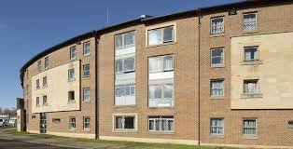
Accommodation
Students undertaking our short term programmes will stay in the brand new, on campus student accommodation located on the River Clyde. This accommodation block is part of the City of Glasgow College £228 million campus development.
Accommodation at Riverside Campus are subject to availability. In the event if the rooms are fully booked, City of Glasgow College will arrange accommodation at St’ Luke Terrace.
Rooms can be either single or twin sharing. Due to the high demand at Riverside Campus, students are encouraged to confirm their trip 7 weeks in advance.
Riverside Campus (accommodation block is on the right hand side)
St Luke’s Terrace

Slide 27
Study Tours
Participants will attain a Certificate of Participation after they complete their immersion experiences at City of Glasgow College.

